Slide 1


Course Structure
Period End Closing Overview
Period End Closing Key Process Areas and New Period End Checks
Post Closing Activities
Year End Specific Closing Activities

Slide 2

Year End Specific Closing Activities
Balance Carry Forward for Receivables/
Payables
Asset Accounting Fiscal Year Close
G/L Balance Carry Forward
T-Code: F.07
T-Code:
AJAB
T-Code:
FAGLGVTR
FCC Task: GBS/JTBC Level
FCC Task: Entity Level
FCC Task: GBS/JTBC Level
Timing: WD4
Timing: WD-1
Timing:
WD1 and WD14
The above activities are performed after the relevant accounts are closed for the year, e.g. Receivable/Payable carry forward can’t be done before all AR/AP accounts are finalized for P12 of the year. There is no specific dependency between the carry forward of different types of accounts, but they are scheduled in FCC each at a specific time.
In S/4 each FCC Periodic Task List is indicated with a Closing Type of M/Q/Y (Monthly/Quarterly/Yearly). This allows different tasks to be included in different closing types and potentially have different scheduled times for monthly/quarterly/yearly closing if needed, e.g. some tasks need to be done earlier during Year end closing only. The above activities are Yearly tasks which only exist in P12 closing task list, which should be indicated with Closing Type Y in the Task List Basic Data.

Slide 3
Period End Closing Execution (GBS/JTBC)
Balance Carry Forward for Receivables/Payables
Year End Specific Closing Activities
Asset Accounting Fiscal Year Close
G/L Balance Carry Forward

Slide 4
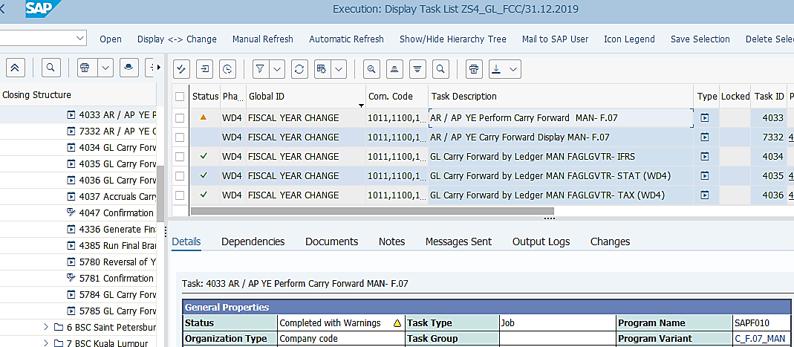
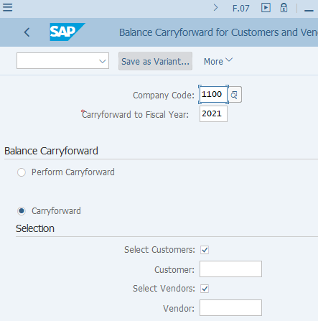
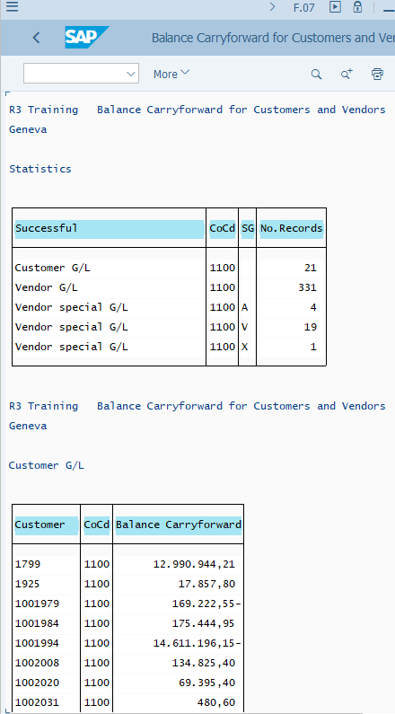
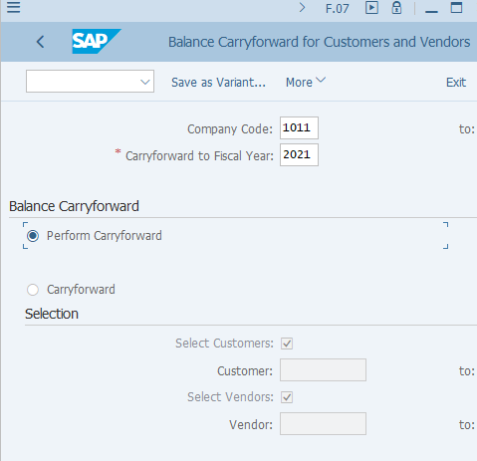
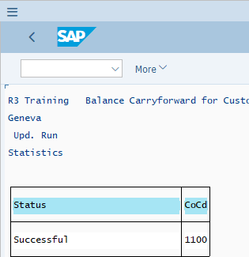
Balance Carry forward for Receivables/Payables: Execution
FCLOCO: FCC Task List
This is a GBS/JTBC variants, using Company Code variables.
You will notice two FCC tasks for F.07.
The first task performs the actual Carry Forward however without a detailed list
The second task displays what has been carried forward. This may be particularly important in case you/or entities need to retain and check some details when things go wrong
If you need to execute F.07 outside of FCC you should also follow the sequence as in FCC.
You should also check/amend the Company Code and the new Fiscal Year before execution outside of FCC.

Slide 5
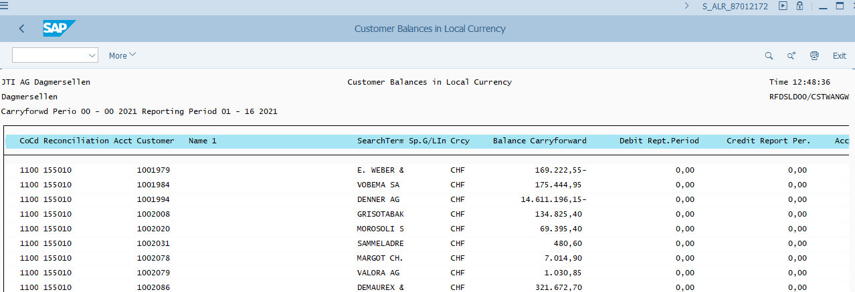
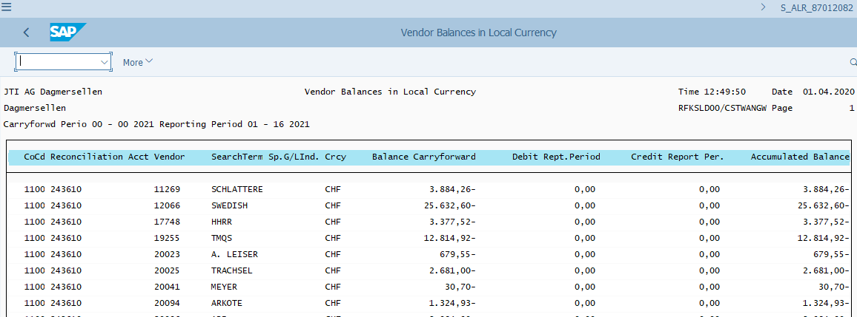
Balance Carry forward for Receivables/Payables: Validation
S_ALR_87012172: Customer Balances in Local Currency
Upon the execution of F.07, you can see the Balance Carryforward columns filled on the Customer/Vendor Balances reports.
It is not required for GBS/JTBC teams to check these reports upon the execution of carry forward, however it is important to understand that if the Balance Carry Forward isn’t done correctly, these reports will not show any value in the Balance Carryforward column.
S_ALR_87012082: Vendor Balances in Local Currency

Slide 6
Period End Closing Execution (GBS/JTBC)
Balance Carry Forward for Receivables/Payables
Year End Specific Closing Activities
Asset Accounting Fiscal Year Close
G/L Balance Carry Forward

Slide 7
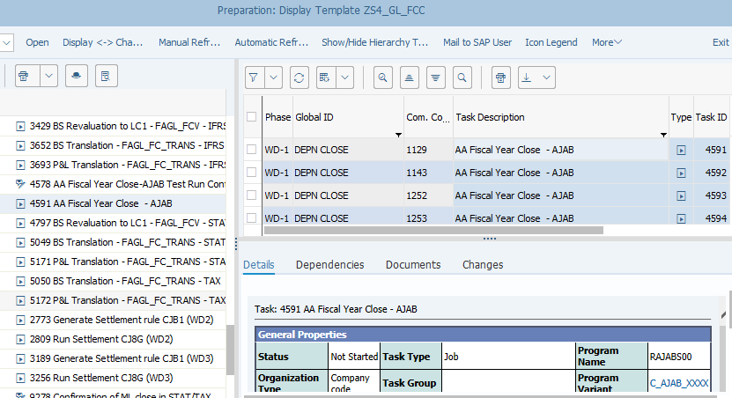
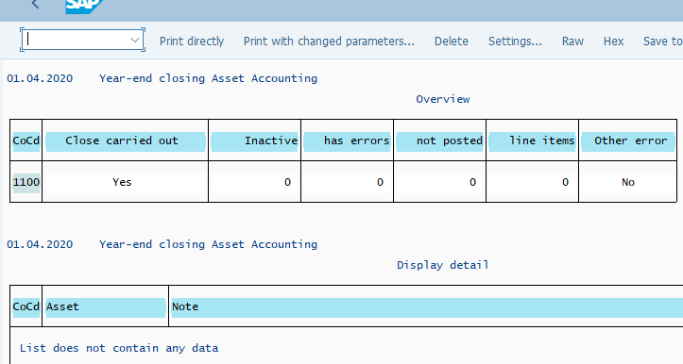
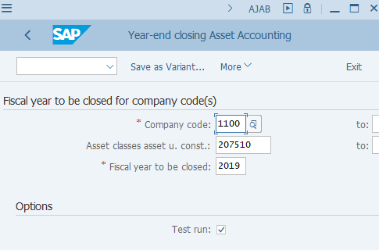
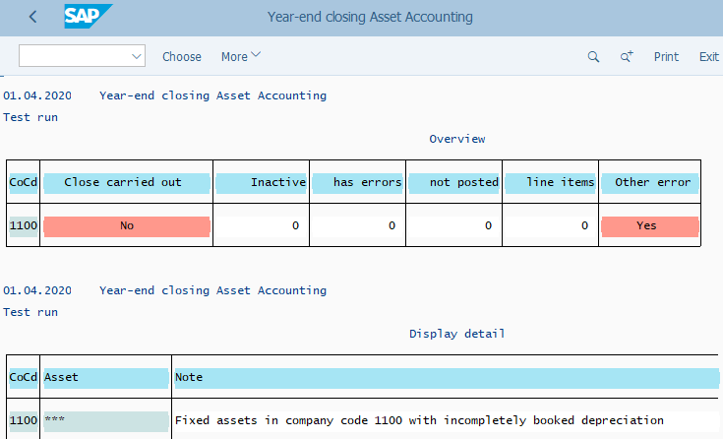
Asset Accounting Fiscal Year Close
FCLOCO: FCC Task List
AJAB: AA YE Closing – Update Run log (SM37 spool)
This is a global variants using Company Code variables.
It is important to carry out the Test Run for AA FY Closing as various errors can occur.
The system requires all AA related postings, especially all depreciation postings have been done before a fiscal year can be closed in AA module. This is one of the most common errors if you can’t close a fiscal year in AA.
You should check/amend the Company Code and the Fiscal year to be closed before execution outside of FCC.
Update Run needs to be carried out via Background processing (under “More” menu).
Once the Update Run is completed, the system does not allow any posting to AA module in the closed fiscal year.
Note that this transaction doesn’t impact whether posting to AA module in the New Fiscal Year is allowed, which is controlled by the G/L Carry Forward transaction.
AJAB: AA YE Closing
AJAB: AA YE Closing – Test Run log

Slide 8
Asset Accounting Fiscal Year Close - Common Error
Detail of the “Errors” can be checked from the “Output Logs”. GL Team needs to check the error and work as per the resolution mentioned below.
Errors | Error Description (Reason) | Resolution
Company Code XXXX contains fixed assets with calculations with errors | In company code XXXX, not all depreciation values have been calculated completely and correctly. | Recalculate depreciation for company code XXXX: For this you can follow either one of the below 2 steps. In the “SAP Easy Access Menu” under Accounting->Fixed Assets->Environment->Recalculate Values Or, Use T-Code “ AFAR” By doing this, system will either fully recalculate the depreciation for the affected Fixed Assets or gives an error details why the recalculation of depreciation can not be done.
Asset is not fully completed | Asset master data not completed | This would be the case when mandatory fields are missing in the Asset. e.g., Cost Center, Responsible Cost Center. Contact the Market to update these fields using the T-Code “AS02”. After the change re-run the process.
Asset not yet capitalized, although an acquisition exists | Asset not yet capitalized, although an acquisition exists | Add first Acquisition date for Asset using the T-Code “AS02”- same case for Asset in Use and Construction In Progress (CIP) - Add Capitalization Date

Slide 9
Period End Closing Execution (GBS/JTBC)
Balance Carry Forward for Receivables/Payables
Year End Specific Closing Activities
Asset Accounting Fiscal Year Close
G/L Balance Carry Forward

Slide 10
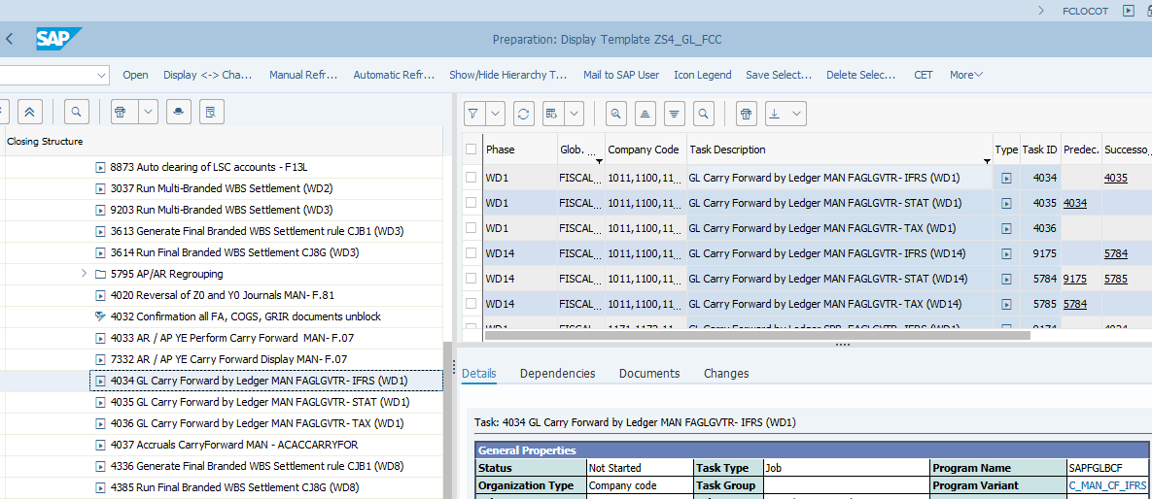
G/L Balance Carry Forward: Execution (1/2)
FCLOCO: FCC Task List
The variants used in G/L Balance Carry Forward are GBS/JTBC variants containing all entities with a given GBS/JTBC, therefore the Company Code variable should be used. You should review/amend the Company Codes included before executing the transaction outside of FCC to ensure they meet your purpose of execution. The Fiscal Year should also be check and amended if needed as it uses the variable for fiscal year.
In S/4 HANA. The new G/L Balance Carry Forward transaction not only replaces the ECC G/L Balance Carry Forward transaction, but also the Asset Fiscal Year Change transaction (AJRW – now obsolete in S/4 HANA).
As a result, when a new fiscal year begins, G/L Balance Carry Forward for all ledgers should be executed at the beginning of the fiscal year to allow Asset transactions to be posted in the new fiscal year. This is therefore scheduled on WD1 to enable the Asset posting in the new year.
Technically the FAGLGVTR transaction only needs to be executed once for one ledger, which is able to pick up any further postings in the previous year and automatically carry them over to the new fiscal year. But as JTI finalizes closing after WD1 (WD3 for IFRS and WD14 for STAT and TAX), carry forward tasks have been scheduled again on WD14 for all ledgers. “Reset Balance Carryfoward” option is used for WD14 runs. (See explanation on the next slide)

Slide 11
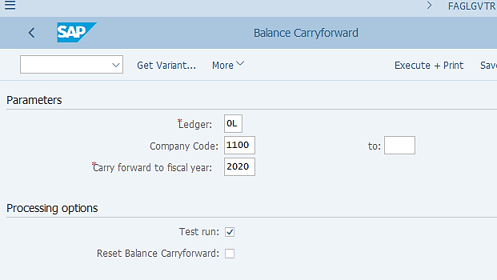
G/L Balance Carry Forward: Execution (1/2)
FAGLGVTR: G/L Balance Carry forward
The G/L Balance Carryforward transaction is to be done for each core ledger at a time. No carry forward is scheduled for Extension Ledgers S1 and T1 because key reports for these extension ledgers (CBCR and TIR), do not rely on balance carried forward.
In FCC, all entities belong to one GBS/JTBC are included in one variant for the respective GBS/JTBC to execute the carryforward. If you are doing any extra runs outside of FCC, you may use the GBS/JTBC variant but include only the company code for which you need to run the carryforward.
This is the New Fiscal Year to which you want the balances to be carried over.
Test Run is not selected in FCC variant but you should do a Test Run first if you execute carry forward outside of FCC. This will allow you to see any errors which should be corrected before an Update Run. Errors can include for example some P&L accounts are not assigned to a P&L Statement Account type.
In S/4HANA, carry forward line items are added to ACDOCA table with unique document numbers and status once carry forward is executed. (However end users can’t display these items via FAGLB03/FAHLL03, etc.) So if you perform carry forward early in the new year but subsequently you did some adjustments in the old fiscal year, although the system will automatically adjust the “balance carryforward” without you performing the carryforward again, it also adds a large number of carry forward line items in ACDOCA to reflect your old balance adjustments. To reduce the database footprint, you can perform carryforward again with this indicator selected, which will remove the initial carryforward items and re-write them based on the updated balance carryforward.

Slide 12
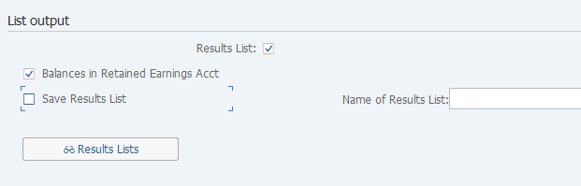
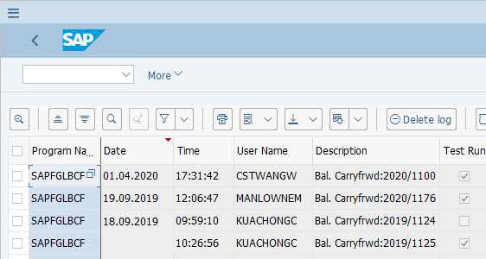
G/L Balance Carry Forward: Execution (2/2)
FAGLGVTR: G/L Balance Carry forward
Results list should be selected so that upon execution of the transaction you receive a list of what balances have been carried forward to the new year. This should include 2 main parts: 1) P&L account balances are carried over to their corresponding Retained Earning accounts; 2) Balance Sheet account balances are carried over to the same accounts.
Select this option so that the P&L account balances are carried over to their corresponding Retained Earning accounts in the new fiscal year.
In the FCC variants the Save Results List option is not selected. This option will save the result list from each execution of the carryforward transaction and allow you to display these lists later on directly from this screen. You can even give it a name if you wish to. It is normally not required as we would have the list stored in the FCC task if the carry forward is executed via FCC. You may wish to use this option if you are executing the carry forward outside of FCC and you are not using Background processing, so that you have this result list saved here and can display it later on.

Slide 13
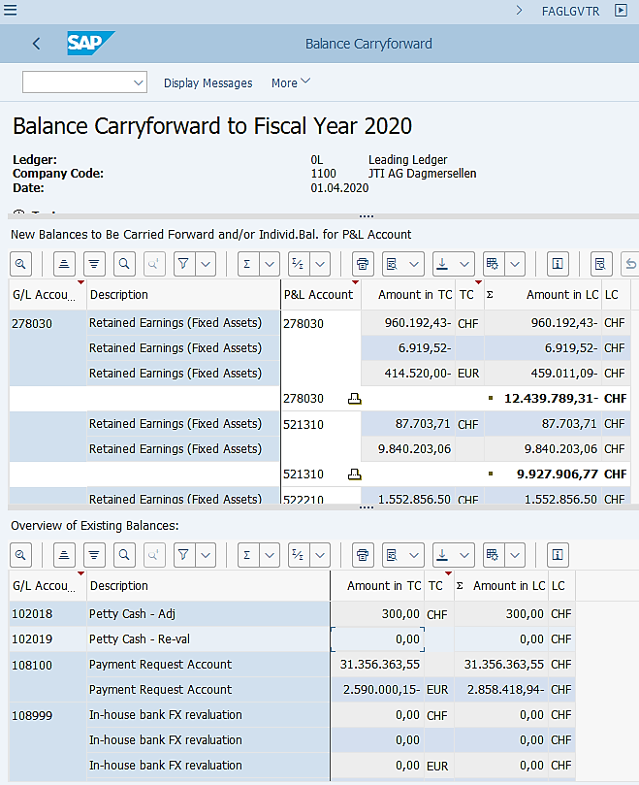
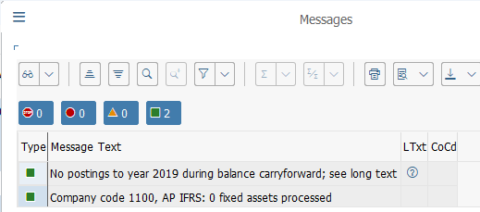
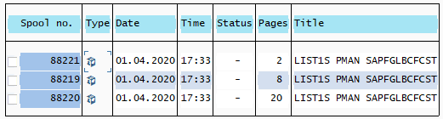
G/L Balance Carry Forward: Output
FAGLGVTR: G/L Balance Carry forward Output (foreground run)
If the transaction is executed foreground, you will see the detailed balance carry forward list on the screen.
You should check if there’s any error message during the test run and get them corrected before doing an update run. Note you may also have errors during update run so you should check messages in all cases.
1) P&L to Retained Earning
You can execute the transaction in background (FCC always executes it in background).
You should check “All Spool Lists” for this particular background job, where you should find 3 spool lists as shown below. These three lists contain the corresponding information as you would find when you execute the transaction foreground.
2) B/S to B/S
FAGLGVTR: G/L Balance Carry forward Output (background run spool)

Slide 14
G/L Balance Carry Forward - Common Error
Errors | Error Description (Reason) | Resolution
ERRORS OCCURRED! Please read long text for details! ERRORS OCCURRED! FINS_BCF_EN 019 I Run 1417 didn't process specified ledgers, company codes, and FY. FINS_BCF_EN 070 E Job canceled after system exception ERROR_MESSAGE | Not enough memory due to large number active processes | GL Team needs to restart task
No error but processes for entities with large numbers entries can take many hour | Not error but processes for entities with large numbers entries can take many hour | GL Team needs to wait until the job finished.

Slide 15
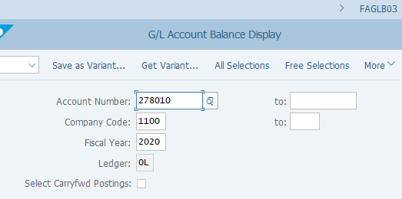
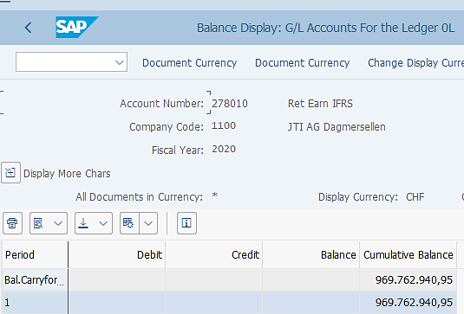
G/L Balance Carry Forward: Validation
FAGLB03: G/L Balance Display
One of the quickest ways to validate if G/L Balance Carry Forward is actually performed is to check the FAGLB03 report.
You may check it for any ledger and any account, which should show a balance in the first row “Bal.Carryforward” if carry foward is done. Normally we would check a retained earning account, as this can tell if P&L accounts have been carried over to retained earnings in the new fiscal year.
You will normally be able to double click the balance you see on FAGLB03 report, however please be aware that the line items you see upon double clicking will not contain the line items that have been added to ACDOCA table during the balance carry forward. This is a technical nature of the system.
You will only see the postings of prior years posted to the account that you are displaying if any of such postings exit.

Slide 16
Demonstration & exercises
Exercise No. 7: Perform G/L Balance Carry Forward using T-Code FAGLGVTR

